Slide 1


IOE 565 Fall 2002 Project
Instructor: Dr. Dragan Djurdjanovic
Forecast of Singapore Birth Rates
December 5th, 2002
Group 24: Foo Kean Lian Chun Ming Wong Cleaven John Yu

Slide 2
Scope of Project
I. General
II. Model: Stationary Series
III. Model: Non-Stationary Series
IV.Forecast
V. Conclusion

Slide 3
Background
Forecasting Singapore birth rates
Aids (government) in efficient planning of education capacities and medical amenities to cater demand
Vital in functioning of small, limited resources country

Slide 4
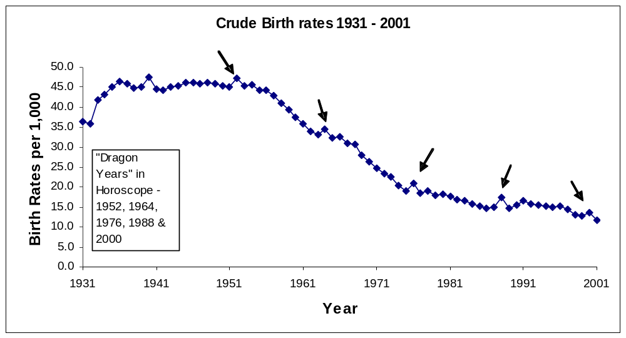
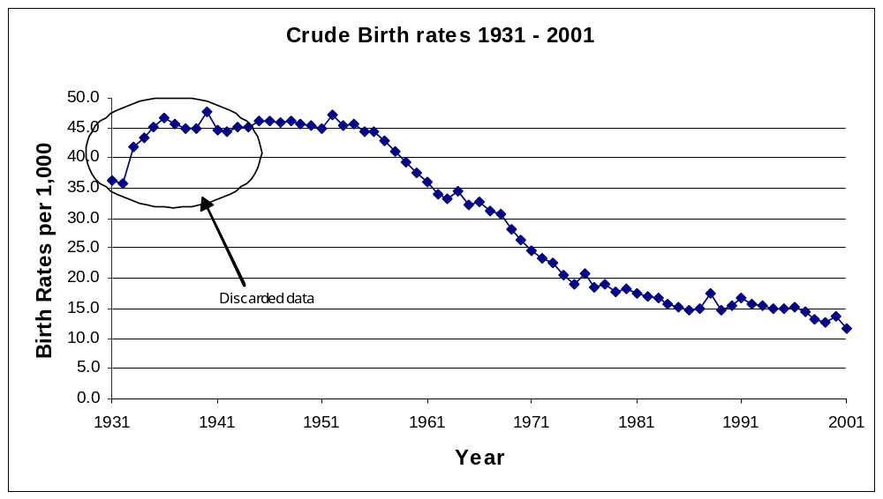
Data Analysis

Slide 5
Data Analysis and Assumptions
Singapore’s population is predominantly Chinese (average 76.5% 1930s – 1980s)
‘Peaks’ every 12 years (e.g. 1952, 1964, 1978, 2000) → seasonality
Coincide with ‘Dragon’ year of Chinese calendar
Falling rates

Slide 6
Scope of Project
I. General
II. Model: Stationary Series
III. Model: Non-Stationary Series
IV.Forecast
V. Conclusion

Slide 7
Modeling Process: Stationary Series
Adequate Model – ARMA (8,7)
Auto Regressive Part:
X_{t} + 0.5349 X_{t-1} - 0.7783 X_{t-2} - 0.5472 X_{t-3} - 0.5136 X_{t-4} - 0.4945 X_{t-5} + 0.7131 X_{t-6} + 0.4862 X_{t-7} - 0.4169X_{t-8}
Moving Average Part:
a_{t} + 1.702 a_{t-1} + 1.21 a_{t-2} + 1.002 a_{t-3} + 0.5913 a_{t-4} + 0.4369 a_{t -5} +1.046 a_{t-6} + 0.7014 a_{t-7}
Residual Sum of Squares = 18.66411

Slide 8
Model Analysis: Stationary Series
Auto Regressive Roots are as follows:
λ₁ = - 0.9904
λ₂ = -0.8884 + 0.4866i
λ₃ = -0.8884 - 0.4866i
λ₄ = -0.0035 + 0.9827i
λ₅ = -0.0035 - 0.9827i
λ₆ = 1.0058
λ₇ = 0.6167 + 0.2049i
λ₈ = 0.6167 - 0.2049i
Moving Average Roots are as follows:
ν₁ = 0.6496 + 0.5847i
ν₂ = 0.6496 - 0.5847i
ν₃ = -0.1202 + 1.0026i
ν₄ = -0.1202 - 1.0026i
ν₅ = -0.8838 + 0.3542i
ν₆ = -0.8838 - 0.3542i
ν₇ = -0.9934

Slide 9
Parsimonious Model
combined operator:
(1 – B) (1 - 1.732B + B²) * X_{t}
reduced autoregressive parameters by 3 and fit an ARMA (5, 7) ← * X_{t}
Auto Regressive Part:
X_{t} – 1.573 X_{t-1} + 0.1445 X_{t-2} +0.5852 X_{t-3} + 0.4221 X_{t-4} - 0.5787 X_{t-5}
Moving Average Part:
a_{t} - 1.027a_{t-1} - 0.5368a_{t-2} + 0.1406a_{t-3} + 0.5922 a_{t-4} + 0.269 a_{t -5} - 0.1087a_{t-6} - 0.3393 a_{t-7}
Residual Sum of Squares = 28.51

Slide 10
Comparing Models
F-criterion test: ARMA (8, 7) v.s. Parsimonious ARMA (5, 7) model
- improvement in Rss significant
Adequate model: ARMA (8, 7) for Birth Rates → initial prediction of Period = 12 years was flawed

Slide 11
Discussion
Actual results: Period = 12.5 years
Over past 10-15 years the proportion of other races has increased ~ 30% of total population
Active policy to lure foreigners to enhance workforce and productivity
Complexity in different cultures increases difficulty in modeling based on the Horoscope
Although Chinese population still ~ 70% of total population, modern Chinese have become less traditional and are becoming more secular

Slide 12
Discussion
46 samples to predict following 12 years
A ‘better’ model ~ 200 samples
Data in yearly intervals
→ limited data
→ poor indication of characteristics and trends of population birth rates of a nation
Developed country with an increasing cost of living → more taxing to have a large family
Trend: 1950’s & 1960’s → 3 children
Trend: 1990’s → 1 to 2 children
Weigh cost of bringing up children over the prosperity or beliefs in Chinese horoscope

Slide 13
Scope of Project
I. General
II. Model: Stationary Series
III. Model: Non-Stationary Series
IV.Forecast
V. Conclusion

Slide 14
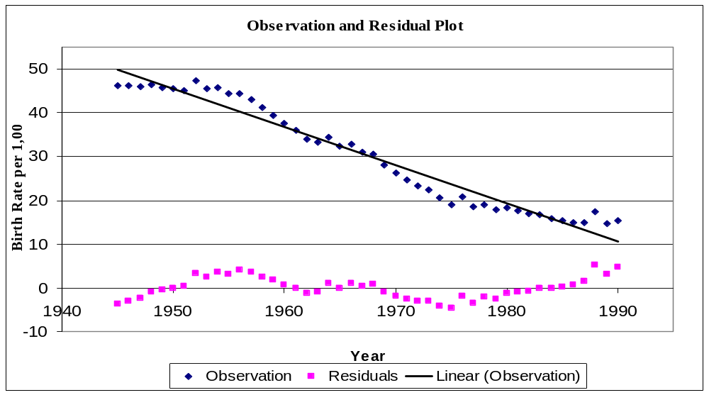
Most residuals are considerably small compared to the corresponding observations

Slide 15
Alternate model: Non-Stationary Series
Deterministic Part
Strong linear trend as observed from the graph
Using least squares to fit a linear regression of form,Y_{t} = β₀ + β₁t + ε_{t}
Birth Rates = 49.8776 – 0.87191t
Where 0 ≤ t ≤ 46 to describe 1945-1990

Slide 16
Alternate model: Non-Stationary Series
Stochastic Part
Subtracting deterministic part from observations
X_{t} = Y_{t} - (β₀ + β₁t)
Adequate model is AR(1):
X_{t} = 0.8687X_{t-1} + a_{t}

Slide 17
Alternate model: Non-Stationary Series
Combined Model
Y(t) = β₀ + β₁t + X(t)
Y_{t} = 49.8776 – 0.87191t + 0.8687X_{t-1} + a_{t}
Deterministic
Stochastic

Slide 18
Scope of Project
I. General
II. Model: Stationary Series
III. Model: Non-Stationary Series
IV.Forecast
V. Conclusion

Slide 19
Forecasting
ARMA (8,7): AR(1)
Ø₁ = -0.5349 Ø₅ = 0.4945 Ø₁ = 0.8687
Ø₂ = 0.7783 Ø₆ = -0.7131
Ø₃ = 0.5472 Ø₇ = -0.4862 θ₁ = 1
Ø₄ = 0.5136 Ø₈ = 0.4169
θ₁ = -1.7020 θ₅ = -0.4369
θ₂ = -1.2100 θ₆ = -1.046
θ₃ = -1.0020 θ₇ = -0.7014
θ₄ = -0.5913
σ_{a}² = 0.6221

Slide 20
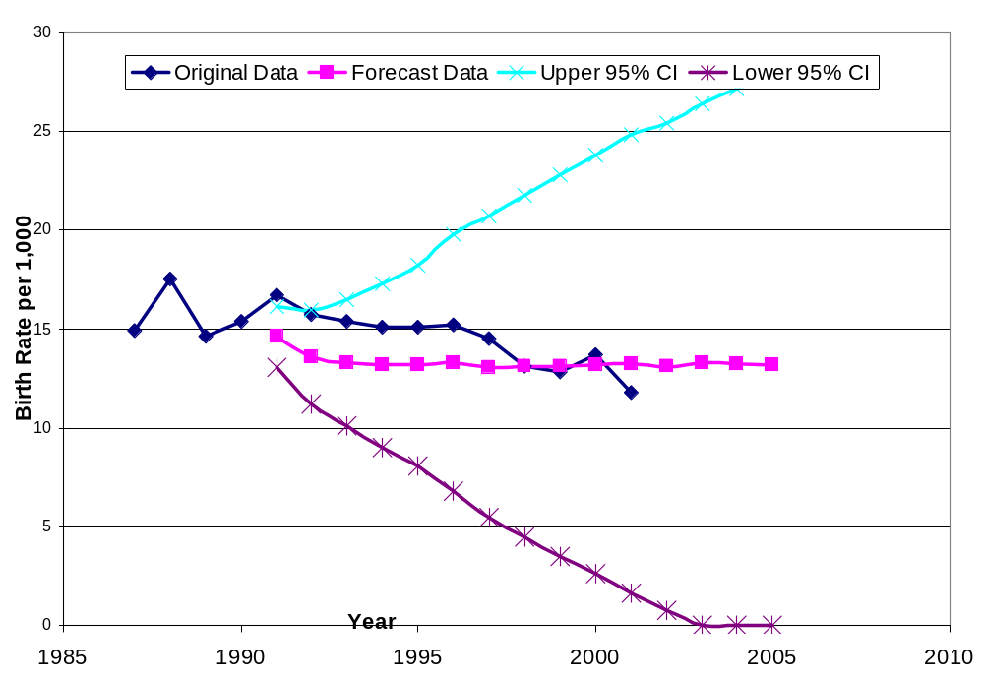
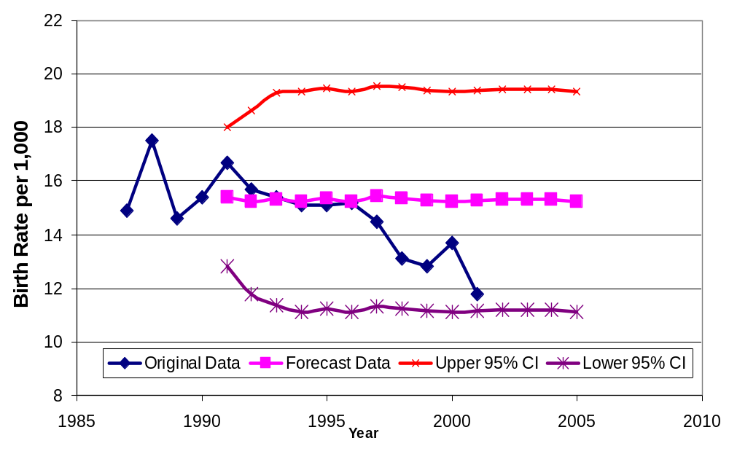
Forecast Models

Slide 21
Reasons for inaccuracy
Sample sized used is too small
~ 200 generally required to obtain a good forecast, sample size of only 46 was used
→ led to the inaccuracy of the forecast
Non-stationary model
Linear trend was primarily based on observation
Possible that an exponential and or polynomial trend may better describe deterministic part

Slide 22
Scope of Project
I. General
II. Model: Stationary Series
III. Model: Non-Stationary Series
IV.Forecast
V. Conclusion

Slide 23
Conclusion
If deterministic part was chosen more precisely, non-stationary model may have given a more accurate forecast
Thus non-stationary models based on polynomial trends, exponential, etc. should be considered and tested the same way as was done for the linear trend analysis
→ may result in a more accurate model and forecast for the birth rates for Singapore

